Slide 1
Machine Learning
Lecture 1

Slide 2
Introduction
We are in the midst of what is popularly called the information revolution—a revolution which was born shortly after the end of World War II.
The new world was the world of machine intelligence and automated reasoning
It was widely believed that there were no limits to what machines could do
The era of thinking machines has arrived

Slide 3
AI and ML
Artificial Intelligence is the broader concept of machines being able to carry out tasks in a way that we would consider “smart”
Machine Learning is a current application of AI based around the idea that we should really just be able to give machines access to data and let them learn for themselves
Summary..
AI is a bigger concept to create intelligent machines that can simulate human thinking capability and behavior, whereas, machine learning is an application or subset of AI that allows machines to learn from data without being programmed explicitly

Slide 4
ANN and Deep Learning
Human brains are made up of connected networks of neurons. ANNs seek to simulate these networks and get computers to act like interconnected brain cells, so that they can learn and make decisions in a more humanlike manner.
An ANN can have only three layers of neurons: the input layer (where the data enters the system), the hidden layer (where the information is processed) and the output layer (where the system decides what to do based on the data)

Slide 5
ANN and Deep Learning
Instead of teaching computers to process and learn from data (which is how machine learning works), with deep learning, the computer trains itself to process and learn from data.
ANN that is made up of more than three layers – i.e. an input layer, an output layer and multiple hidden layers – is called a ‘deep neural network’, and this is what underpins deep learning
A deep learning system is self-teaching, learning as it goes by filtering information through multiple hidden layers, in a similar way to humans
Two are closely connected in that one relies on the other to function. Without neural networks, there would be no deep learning.

Slide 6
INFORMATION SYSTEMS / INTELLIGENT SYSTEMS
INFORMATION
REVOLUTION
INTELLIGENT
SYSTEMS
REVOLUTION
INTERNET SMART CAMERAS
WORLD WIDE WEB SMART APPLIANCES
WIRELESS TELEPHONY SMART CARS
FAX SMART ELEVATORS
DIGITAL LIBRARIES SMART ROBOTS
DATA MINING INTELLIGENT MANUFACTURING
INFORMATION RETRIEVAL EXPERT SYSTEMS
… SMART SEARCH ENGINES
SMART QUALITY CONTROL
…
Measure of intelligence: MIQ (Machine Intelligence Quotient)

Slide 7
What is Machine Learning?
It is very hard to write programs that solve problems like recognizing a face.
We don’t know what program to write because we don’t know how our brain does it.
Even if we had a good idea about how to do it, the program might be horrendously complicated.
Instead of writing a program by hand, we collect lots of examples that specify the correct output for a given input.
A machine learning algorithm then takes these examples and produces a program that does the job.
The program produced by the learning algorithm may look very different from a typical hand-written program. It may contain millions of numbers.
If we do it right, the program works for new cases as well as the ones we trained it on.

Slide 8
Machine Learning: More Specific..
A computer program is said to learn from experience E with respect to some class of tasks T and performance measure P, if its performance at tasks in T, as measured by P, improves with experience E.

Slide 9
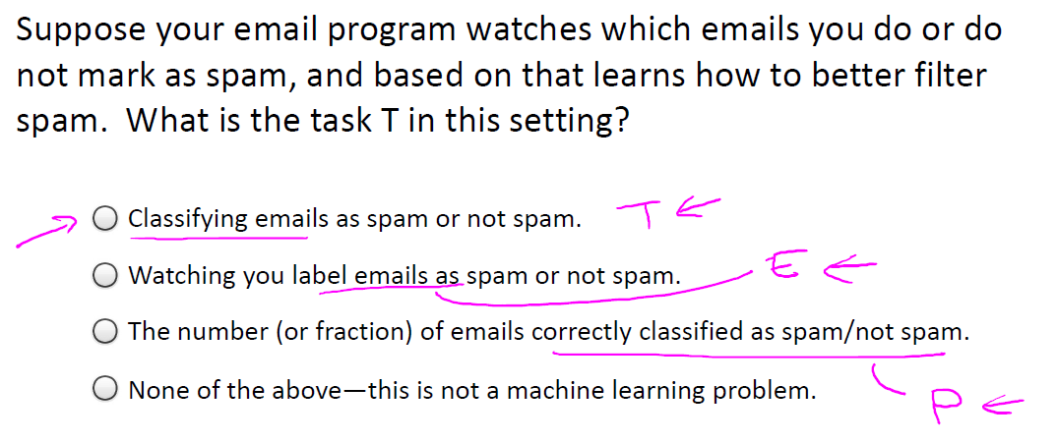
Machine Learning: More Specific..

Slide 10


What Is Machine Learning?
“Logic is not the end of wisdom, it is just the beginning” --- Spock
Environment
same
time
Environment
System
System
Action₁
Action₂
Knowledge
Knowledge
changed

Slide 11
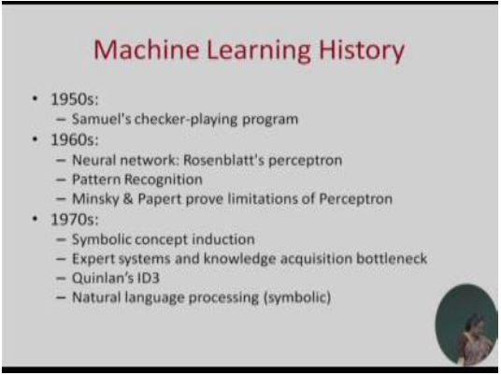
History of ML

Slide 12
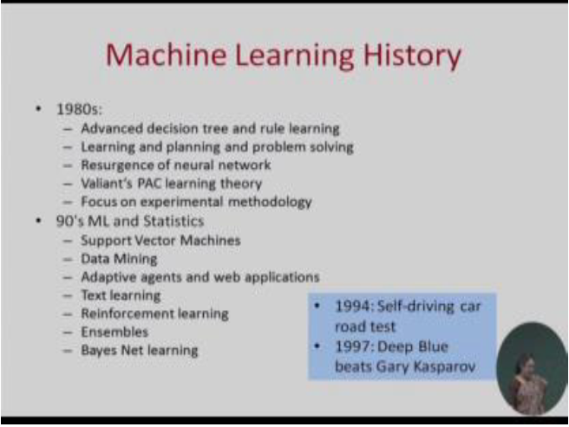
History of ML

Slide 13
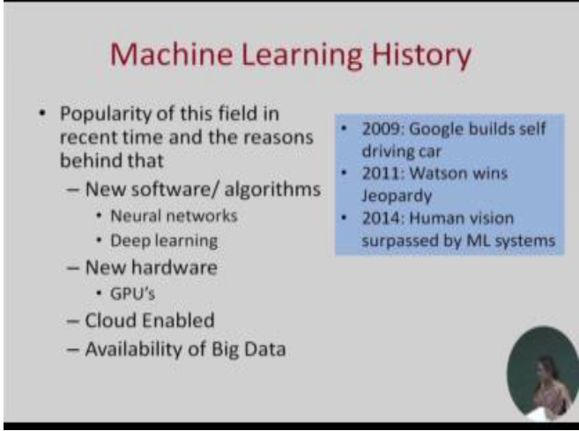
History of ML

Slide 14
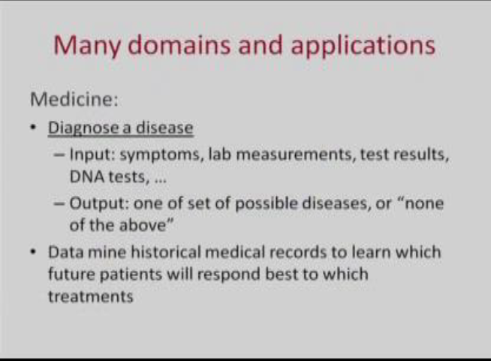
Applications of ML

Slide 15
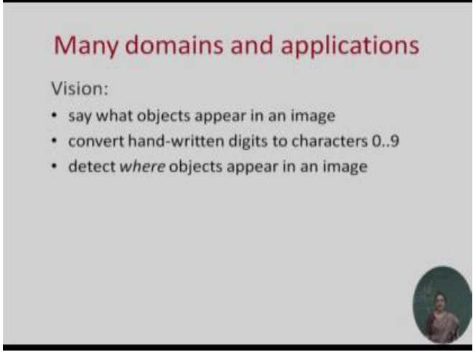
Applications of ML

Slide 16
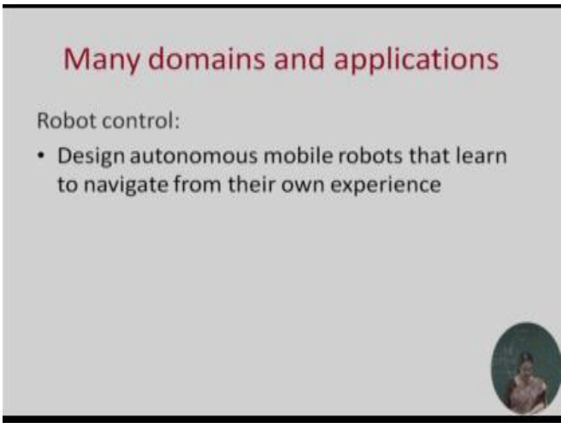
Applications of ML

Slide 17
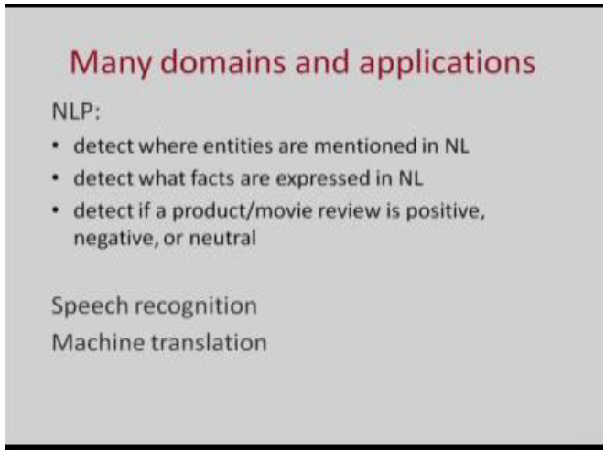
Applications of ML

Slide 18
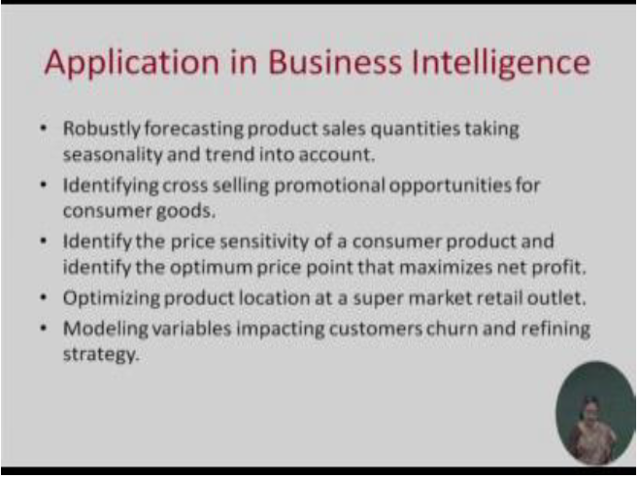
Applications of ML

Slide 19
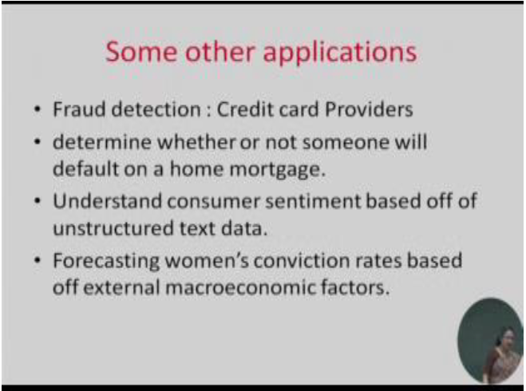
Applications of ML

Slide 20
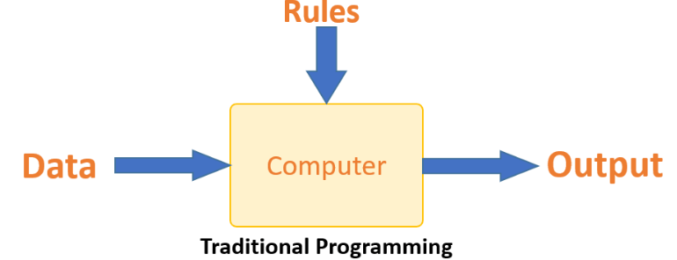
ML vs Traditional Programming
Traditional programming differs significantly from machine learning. In traditional programming, a programmer code all the rules in consultation with an expert in the industry for which software is being developed. Each rule is based on a logical foundation; the machine will execute an output following the logical statement. When the system grows complex, more rules need to be written. It can quickly become unsustainable to maintain.

Slide 21
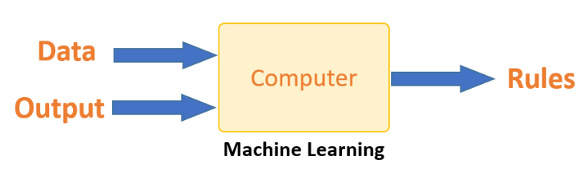
ML vs Traditional Programming
Machine learning is supposed to overcome this issue. The machine learns how the input and output data are correlated and it writes a rule. The programmers do not need to write new rules each time there is new data. The algorithms adapt in response to new data and experiences to improve efficacy over time.

Slide 22
Some more examples of tasks that are best solved by using a learning algorithm
Recognizing patterns:
Facial identities or facial expressions
Handwritten or spoken words
Medical images
Generating patterns:
Generating images or motion sequences
Recognizing anomalies:
Unusual sequences of credit card transactions
Unusual patterns of sensor readings in a nuclear power plant or unusual sound in your car engine.
Prediction:
Future stock prices or currency exchange rates

Slide 23
Some web-based examples of machine learning
The web contains a lot of data. Tasks with very big datasets often use machine learning
especially if the data is noisy or non-stationary.
Spam filtering, fraud detection:
The enemy adapts so we must adapt too.
Recommendation systems:
Lots of noisy data. Million dollar prize!
Information retrieval:
Find documents or images with similar content.
Data Visualization:
Display a huge database in a revealing way

Slide 24
Why is Machine Learning Important?
Some tasks cannot be defined well, except by examples (e.g., recognizing people).
Relationships and correlations can be hidden within large amounts of data. Machine Learning/Data Mining may be able to find these relationships.
Human designers often produce machines that do not work as well as desired in the environments in which they are used.

Slide 25
The amount of knowledge available about certain tasks might be too large for explicit encoding by humans (e.g., medical diagnostic).
Environments change over time.
New knowledge about tasks is constantly being discovered by humans. It may be difficult to continuously re-design systems “by hand”.

Slide 26
Areas of Influence for Machine Learning
Statistics: How best to use samples drawn from unknown probability distributions to help decide from which distribution some new sample is drawn?
Brain Models: Non-linear elements with weighted inputs (Artificial Neural Networks) have been suggested as simple models of biological neurons.
Adaptive Control Theory: How to deal with controlling a process having unknown parameters that must be estimated during operation?
Psychology: How to model human performance on various learning tasks?

Slide 27
5. Artificial Intelligence: How to write algorithms to
acquire the knowledge humans are able to acquire,
at least, as well as humans?
6.Evolutionary Models: How to model certain
aspects of biological evolution to improve the
performance of computer programs?

Slide 28
Designing a Learning System
In designing a learning system, we have to deal with (at least) the following issues:
1. Training experience
2. Target function
3. Learned function
4. Learning algorithm
Training Experience
Issues concerning the training experience:
Direct or indirect evidence (supervised or unsupervised).
Controlled or uncontrolled sequence of training examples.
Representatively of training data in relation to test data.

Slide 29
Target Function and Learned Function
The problem of improving performance can often be reduced to the problem of learning some particular target function.
In many cases we can only hope to acquire some approximation to the ideal target function.
Learning Algorithm
In order to learn the (approximated) target function we require:
A set of training examples (input arguments)
A rule for estimating the value corresponding to each training example (if this is not directly available)
An algorithm for choosing the function that best fits the training data

Slide 30
Types of Machine Learning
Rote learning – One-to-one mapping from inputs to stored representation. “Learning by memorization.” Association-based storage and retrieval.
Induction – Use specific examples to reach general conclusions
Clustering – Unsupervised identification of natural groups in data
Analogy – Determine correspondence between two different representations
Discovery – Unsupervised, specific goal not given
Genetic algorithms – “Evolutionary” search techniques, based on an analogy to “survival of the fittest”
Reinforcement – Feedback (positive or negative reward) given at the end of a sequence of steps

Slide 31
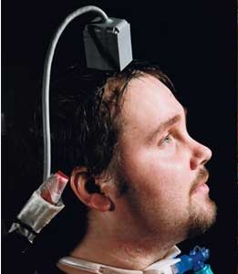
Machine Learning Application
Brain -Computer Interface
Direct Neural Interface or Brain-Machine Interface
Direct communication pathway between a brain and an external device.
Research on BCIs began in the
1970s at the University of
California Los Angeles

Slide 32
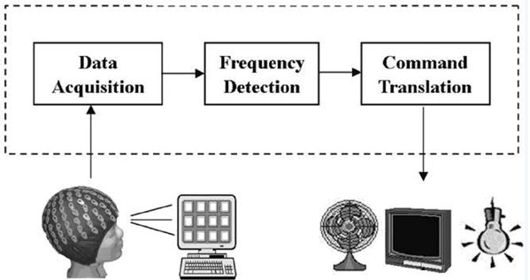
How does it work?
Signal Acquisition
Signal Processing
Devices

Slide 33
Brain Wave Control

Slide 34
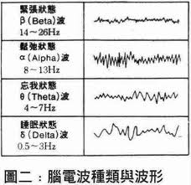
Brain Wave Control
α (8 – 12 Hz): relaxed/reflecting
β (12 – 30 Hz): alert/working
- Training
- Misjudgment

Slide 35
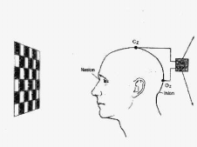
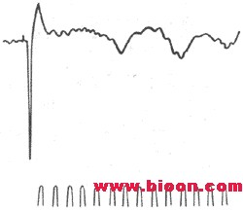

Slide 36
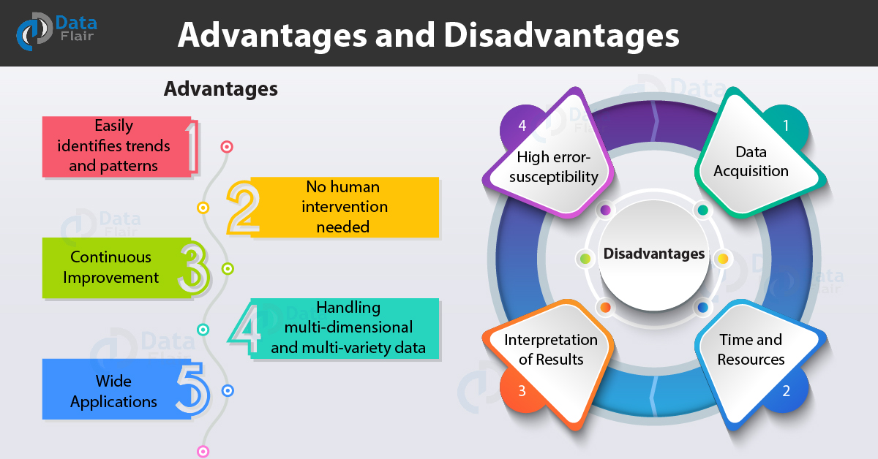
Advantages and Disadvantages

